Slide 1









Slide 2
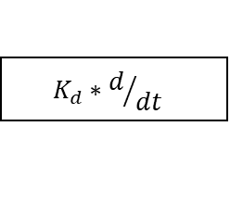





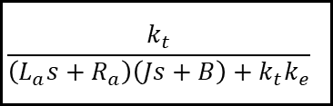




$$K_{P}$$
SP
err
+
CO
+
$$\frac{k_{t}}{\left(L_{a}s+R_{a}\right)\left(Js+B\right)+k_{t}k_{e}}$$
Y
$$K_{I}∗\int{dt}$$
+
-
FB
$$K_{d}∗d/{dt}$$
${L_{a}\frac{di_{a}}{dt}+R_{a}i}_{a}=u_{a}$- $K_{e}ω$
$J\frac{dω}{dt}+Bω =k_{t}∙i_{a}$- $T_{L}$

Slide 3







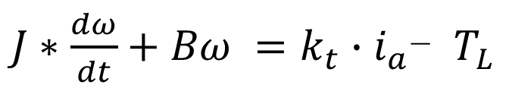



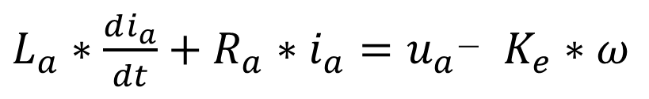

${L_{a}∗\frac{di_{a}}{dt}+R_{a}∗i}_{a}=u_{a}$- $K_{e}∗ω$
$J∗\frac{dω}{dt}+Bω =k_{t}∙i_{a}$- $T_{L}$

Slide 4
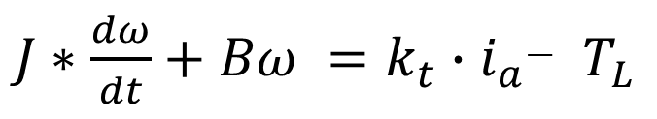
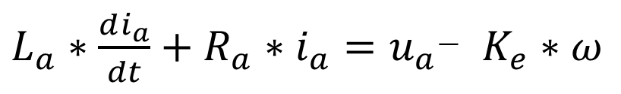
${L_{a}∗\frac{di_{a}}{dt}+R_{a}∗i}_{a}=u_{a}$- $K_{e}∗ω$
$J∗\frac{dω}{dt}+Bω =k_{t}∙i_{a}$- $T_{L}$

Slide 5

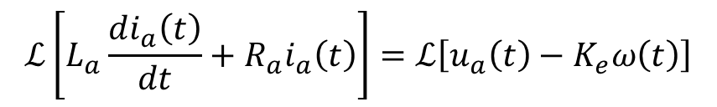
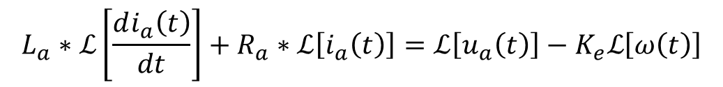








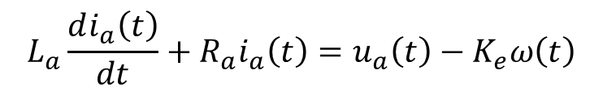
Ra
La
$$ℒ\left[L_{a}\frac{di_{a}\left(t\right)}{dt}+R_{a}i_{a}\left(t\right)\right]=ℒ\left[u_{a}\left(t\right)−K_{e}ω\left(t\right)\right]$$
Ua(t)
ia(t)
$$L_{a}∗ℒ\left[\frac{di_{a}\left(t\right)}{dt}\right]+R_{a}∗ℒ\left[i_{a}\left(t\right)\right]=ℒ\left[u_{a}\left(t\right)\right]−K_{e}ℒ\left[ω\left(t\right)\right]$$
e(t)=keω(t)
$$L_{a}\frac{di_{a}\left(t\right)}{dt}+R_{a}i_{a}\left(t\right)=u_{a}\left(t\right)−K_{e}ω\left(t\right)$$
$$L_{a}sI_{a}\left(s\right)+R_{a}I_{a}\left(s\right)=U_{a}\left(s\right)−K_{e}ω\left(s\right)$$
$$\left(L_{a}s+R_{a}\right)I_{a}\left(s\right)=U_{a}\left(s\right)−K_{e}ω\left(s\right)$$

Slide 6



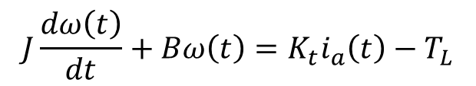


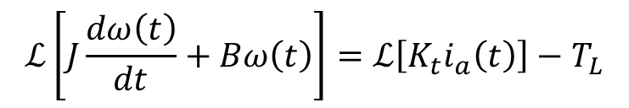

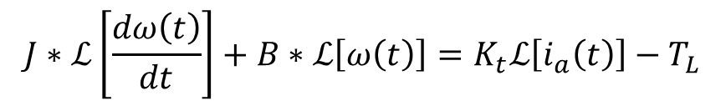
$$ℒ\left[J\frac{dω\left(t\right)}{dt}+Bω\left(t\right)\right]=ℒ\left[K_{t}i_{a}\left(t\right)\right]−T_{L}$$
$$T_{m}=k_{t}∗i_{a}$$
$$Bω$$
$$T_{L}$$
$$J$$
$$J∗ℒ\left[\frac{dω\left(t\right)}{dt}\right]+B∗ℒ\left[ω\left(t\right)\right]=K_{t}ℒ\left[i_{a}\left(t\right)\right]−T_{L}$$
$$J\frac{dω\left(t\right)}{dt}+Bω\left(t\right)=K_{t}i_{a}\left(t\right)−T_{L}$$
$$Jsω\left(s\right)+Bω\left(s\right)=K_{t}I_{a}\left(s\right)−T_{L}$$
$$\left(Js+B\right)ω\left(s\right)=K_{t}I_{a}\left(s\right)−T_{L}$$

Slide 7

$$\left(L_{a}s+R_{a}\right)I_{a}\left(s\right)=U_{a}\left(s\right)−K_{e}ω\left(s\right)$$
$$\left(Js+B\right)ω\left(s\right)=K_{t}I_{a}\left(s\right)−T_{L}$$

Slide 8

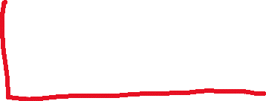



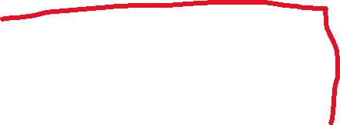

$$K_{P}$$
SP
err
+
CO
+
$$\frac{k_{t}}{\left(L_{a}s+R_{a}\right)\left(Js+B\right)+k_{t}k_{e}}$$
Y
$$K_{I}∗\int{dt}$$
+
-
FB
$$K_{d}∗d/{dt}$$
${L_{a}\frac{di_{a}}{dt}+R_{a}i}_{a}=u_{a}$- $K_{e}ω$
$$\left(L_{a}s+R_{a}\right)I_{a}\left(s\right)=U_{a}\left(s\right)−K_{e}ω\left(s\right)$$
$J\frac{dω}{dt}+Bω =k_{t}∙i_{a}$- $T_{L}$
$$\left(Js+B\right)ω\left(s\right)=K_{t}I_{a}\left(s\right)−T_{L}$$

